Slide 1

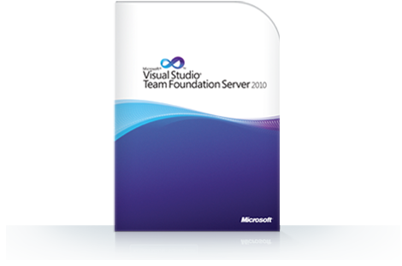

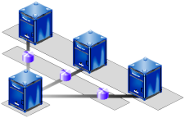

Source Control Systems
Source Control Repositories for Team Collaboration: SVN, TFS, Git
Software Engineering
Telerik Software Academy
academy.telerik.com

Slide 2
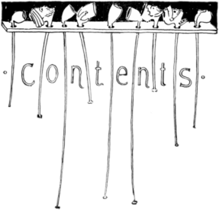
Table of Contents
Software Configuration Management (SCM)
Version Control Systems: Philosophy
Versioning Models
Lock-Modify-Unlock
Copy-Modify-Merge
Distributed Version Control
Tags and Branching
Subversion, Git, TFS – Demo
Project Hosting Sites

Slide 3
Software Configuration Management (SCM)
Version Control ≈ Software Configuration Management (SCM)
A software engineering discipline
Consists of techniques, practices and tools for working on shared source code and files
Mechanisms for management, control and tracking the changes
Defines the process of change management
Keeps track of what is happening in the project
Solves conflicts in the changes

Slide 4
SCM and the Software Development Lifecycle
Release
The Final
Product
Testing
Analysis
Text
Scripts
and Data
Requirements
SCM
Build
Scripts,
Final
Product
Models
Build
Design
Source Code
Implementation

Slide 5

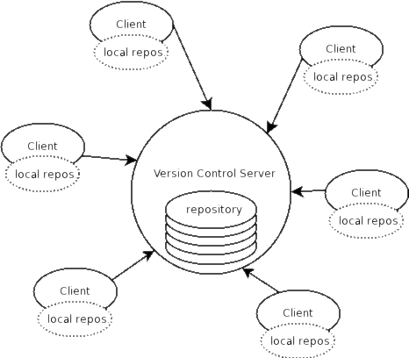

Version Control
Managing Different Version of the Same File / Document

Slide 6

Version Control Systems (VCS)
Functionality
File versions control
Merge and differences search
Branching
File locking
Console and GUI clients
Well known products
CVS, Subversion (SVN) – free, open source
Git, Mercurial – distributed, free, open source
Perforce, Microsoft TFS – free

Slide 7
Version Control
Constantly used in software engineering
During the software development
While working with documents
Changes are identified with an increment of the version number
for example 1.0, 2.0, 2.17
Version numbers are historically linked with the person who created them
Full change logs are kept

Slide 8
Change Log
Systems for version control keep a complete change log (history)
The date and hour of every change
The user who made the change
The files changed + old and new version
Old versions can be retrieved, examined and compared
It is possible to return to an old version (revert)

Slide 9
Vocabulary
Repository (source control repository)
A server that stores the files (documents)
Keeps a change log
Revision, Version
Individual version (state) of a document that is a result of multiple changes
Check-Out, Clone
Retrieves a working copy of the files from a remote repository into a local directory
It is possible to lock the files

Slide 10
Vocabulary (2)
Change
A modification to a local file (document) that is under version control
Change Set, Change List
A set of changes to multiple files that are going to be committed at the same time
Commit, Check-In
Submits the changes made from the local working copy to the repository
Automatically creates a new version
Conflicts may occur!

Slide 11
Vocabulary (3)
Conflict
The simultaneous change to a certain file by multiple users
Can be solved automatically and manually
Update, Get Latest Version, Fetch / Pull
Download the latest version of the files from the repository to a local working directory
Undo Check-Out, Revert / Undo Changes
Cancels the local changes
Restores their state from the repository

Slide 12
Vocabulary (4)
Merge
Combines the changes to a file changed locally and simultaneously in the repository
Can be automated in most cases
Label, Tag
Labels mark with a name a group of files in a given version
For example a release
Branching
Division of the repositories in a number of separate work flows

Slide 13

Version Control: Typical Scenario
Users
Repository
Main
development
line (trunk)
User A
Version A Branch
Version A.1 Branch
Check Out
Check In
C
A
User B
B
Version B Branch
Check Out
D
Merge
E
Check In

Slide 14
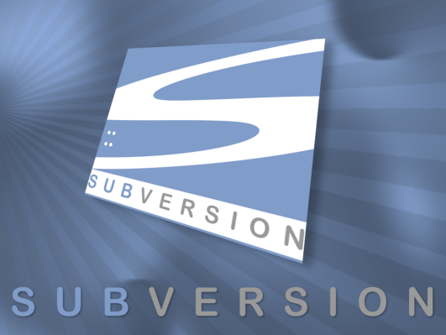
Subversion
Using Subversion and TortoiseSVN

Slide 15
Subversion (SVN)
Subversion (SVN)
Open source SCM repository
http://subversion.tigris.org
Runs on UNIX, Linux, Windows
Console client
svn
GUI client
TortoiseSVN – http://tortoisesvn.tigris.org
Visual Studio / Eclipse plug-ins

Slide 16
Subversion – Features
Versioning of the directory structure
Complete change log
Deletion of files and directories
Renaming of files and directories
Saving of files or directories
Can work on it’s own or integrated with Apache as a module
Works effectively with tags and branching

Slide 17
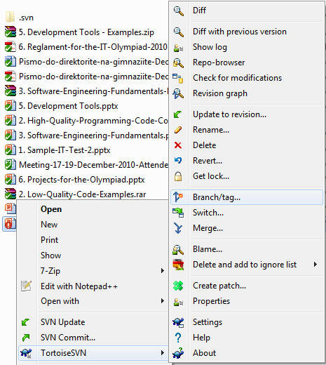
TortoiseSVN
TortoiseSVN
Open source GUI client for Subversion
Integrated in Windows Explorer
http://tortoisesvn.tigris.org

Slide 18



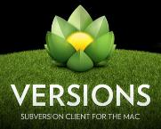
Subversion & TortoiseSVN
Live Demo

Slide 19



Versioning Models
Lock-Modify-Unlock, Copy-Modify-Merge, Distributed Version Control

Slide 20
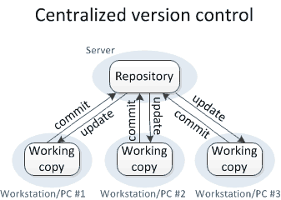
Centralized Version Control
Source: http://homes.cs.washington.edu/~mernst/advice/version-control.html

Slide 21
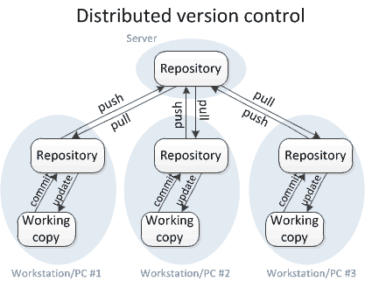
Distributed Version Control
Source: http://homes.cs.washington.edu/~mernst/advice/version-control.html

Slide 22
Versioning Models
Lock-Modify-Unlock
Only one user works on a given file at a time
No conflicts occur
Users wait each other for the locked files → works for small development teams only
Pessimistic concurrency control
Examples:
Visual SourceSafe (old fashioned)
TFS, SVN, Git (with exclusive locking)
Lock-modify-unlock is rarely used

Slide 23
Versioning Models (2)
Copy-Modify-Merge
Users make parallel changes to their own working copies
Conflicts are possible when multiple user edit the same file
Conflicting changes are merged and the final version emerges (automatic and manual merge)
Optimistic concurrency control
Examples:
SVN, TFS, Git

Slide 24
Versioning Models (3)
Distributed Version Control
Users work in their own repository
Using the Lock-Modify-Unlock model
Local changes are locally committed
No concurrency, no local conflicts
From time to time, the local repository is pushed to the central repository
Conflicts are possible and merges often occur
Example of distributed version control systems:
Git, Mercurial

Slide 25
Problems with Locking
Administrative problems:
Someone locks a given file and forgets about it
Time is lost while waiting for someone to release a file → works in small teams only
Unneeded locking of the whole file
Different changes are not necessary in conflict
Example of non-conflicting changes:
Andy works at the begging of the file
Bobby works at the end of the file

Slide 26
Merging Problems
If a given file is concurrently modified, it is necessary to merge the changes
Merging is hard!
It is not always possible to do it automatically
Responsibility and coordination between the developers is required
Commit changes as early as finished
Do not commit code that does not compile or blocks the work of the others
Leave comments at each commit

Slide 27
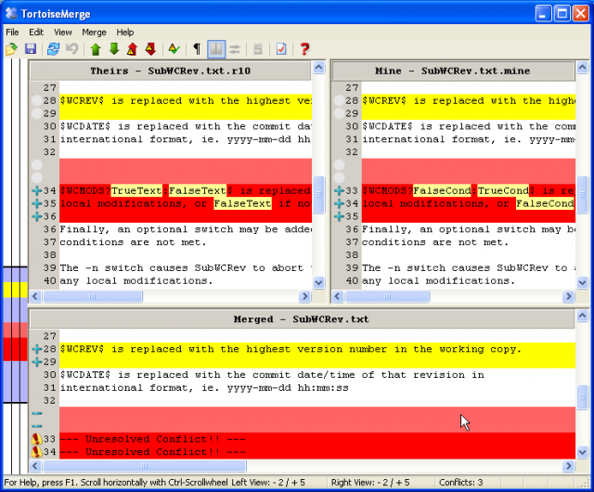
File Comparison / Merge Tools
During manual merge use file comparison
There are visual comparison / merge tools:
TortoiseMerge
WinDiff
AraxisMerge
WinMerge
BeyondCompare
CompareIt
…

Slide 28
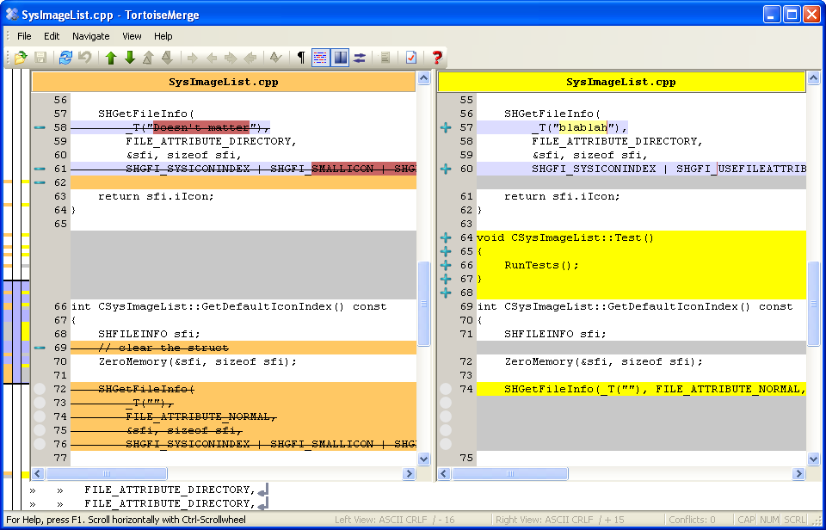
File Comparison – Example

Slide 29



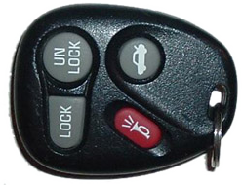
The "Lock-Modify-Unlock" Model

Slide 30

The Lock-Modify-Unlock Model (1)
Andy and Bobby check-out file A.
The check-out is done without locking. They just get a local copy.
Repository
A
Check-out
Check-out
A
A
Bobby
Andy

Slide 31
The Lock-Modify-Unlock Model (2)
Andy locks file A and begins modifying it.
Repository
A
Lock
A
Аndy
(Local Edit)
Bobby
Andy

Slide 32

The Lock-Modify-Unlock Model (3)
Bobby tries to lock the file too, but she can’t.
Bobby waits for Andy to finish and unlock the file.
Repository
A
Wait
A
Andy
Bobby
Andy

Slide 33
The Lock-Modify-Unlock Model (4)
Andy commits his changes and unlocks the file.
Repository
Andy
Commit
A
Andy
Bobby
Andy

Slide 34
The Lock-Modify-Unlock Model (5)
Now Bobby can take the modified file and lock it.
Bobby edits her local copy of the file.
Repository
Andy
Lock
Andy
Andy
(Local Edit)
Bobby
Andy

Slide 35
The Lock-Modify-Unlock Model (6)
Bobby finishes, commits her changes and unlocks the file.
Repository
Andy
Bobby
Commit
Andy
Bobby
Andy
Bobby
Andy

Slide 36
The Lock-Modify-Unlock Model (7)
Andy updates the changes from the repository.
Repository
Andy
Bobby
Update
Andy
Bobby
Andy
Bobby
Bobby
Andy

Slide 37
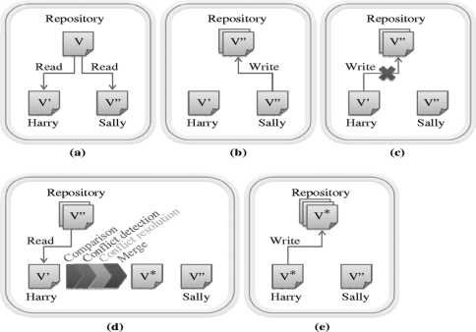
The "Copy-Modify-Merge" Model

Slide 38
The Copy-Modify-Merge Model (1)
Andy and Bobby check-out the file A.
The check-out is done without locking.
Repository
A
Check-out
Check-out
A
A
Bobby
Andy

Slide 39
The Copy-Modify-Merge Model (2)
Both of them edit the local copies of the file (in the same time).
Repository
A
Bobby
Andy
(Local Edit)
(Local Edit)
Bobby
Andy

Slide 40
The Copy-Modify-Merge Model (3)
Bobby commits her changes to the repository.
Repository
Bobby
Commit
Bobby
Andy
Bobby
Andy

Slide 41
The Copy-Modify-Merge Model (4)
Andy tries to commit his changes.
A version conflict occurs.
Repository
Bobby
Commit
Bobby
Andy
(Local Conflict)
Bobby
Andy

Slide 42
The Copy-Modify-Merge Model (5)
Andy updates his changes with the ones from the repository.
The changes merge into his local copy.
A merge conflict can occur.
Repository
Bobby
Update
(with merge)
Bobby
Andy
&
Bobby
(Local Merge)
Bobby
Andy

Slide 43
The Copy-Modify-Merge Model (6)
Andy commits the merged changes to the repository.
A common version with the changes of Andy and Bobby is inserted.
Repository
Andy
&
Bobby
Commit
Bobby
Andy
&
Bobby
Bobby
Andy

Slide 44
The Copy-Modify-Merge Model (7)
Bobby updates the changes from the repository.
She gets the common version with both changes from Andy and Bobby.
Repository
Andy
&
Bobby
Update
Andy
&
Bobby
Andy
&
Bobby
Bobby
Andy

Slide 45
The "Distributed Version Control" Versioning Model

Slide 46
Distributed Version Control (1)
Andy and Bobby clone the master repository locally.
They both have the same files in their local repositories.
Master Repository (Server)
A
Clone
Clone
A
A
Local Repository
(Andy)
Local Repository
(Bobby)
Andy
Bobby

Slide 47
Distributed Version Control (2)
Andy and Bobby work locally on a certain file A.
Master Repository (Server)
A
(Local Edit)
(Local Edit)
Andy
A
A
Bobby
Local Repository
(Andy)
Local Repository
(Bobby)
Andy
Bobby

Slide 48
Distributed Version Control (3)
Andy and Bobby commit locally the modified file A into their local repositories.
Master Repository (Server)
A
Commit (locally)
Commit (locally)
Andy
Andy
Bobby
Bobby
Local Repository
(Andy)
Local Repository
(Bobby)
Andy
Bobby

Slide 49
Distributed Version Control (4)
Andy pushes the file A to the remote (master) repository.
Still no conflicts occur.
Master Repository (Server)
Andy
Push
Andy
Andy
Bobby
Bobby
Local Repository
(Andy)
Local Repository
(Bobby)
Andy
Bobby

Slide 50
Distributed Version Control (5)
Bobby tries to commit his changes.
A versioning conflict occurs.
Master Repository (Server)
Andy
Push (conflict)
Andy
Andy
Bobby
Bobby
Local Repository
(Andy)
Local Repository
(Bobby)
Andy
Bobby

Slide 51
Distributed Version Control (6)
Bobby merges the her local files with the files from the remote repository.
Conflicts are locally resolved.
Master Repository (Server)
Andy
Fetch +
Merge
Andy
Andy
Bobby
+Andy
Bobby
+Andy
Local Repository
(Andy)
Local Repository
(Bobby)
Andy
Bobby

Slide 52
Distributed Version Control (7)
Bobby commits her merged changes.
No version conflict.
Master Repository (Server)
Bobby
+Andy
Andy
Push (no conflict)
Andy
Andy
Bobby
+Andy
Bobby
+Andy
Local Repository
(Andy)
Local Repository
(Bobby)
Andy
Bobby

Slide 53
Distributed Version Control (8)
Andy fetches (updates) the updated files from the remote repository.
Master Repository (Server)
Bobby
+Andy
Andy
Fetch
Bobby
+Andy
Bobby
+Andy
Bobby
+Andy
Bobby
+Andy
Local Repository
(Andy)
Local Repository
(Bobby)
Andy
Bobby

Slide 54


Tags and Branches

Slide 55
Tags
Allows us to give a name to a group of files in a certain version
File A
1.1
1.2
1.3
1.4
Tag "Beta 2"
File B
1.1
1.2
File C
1.1
1.2
1.3

Slide 56
Branching
Branching allows a group of changes to be separated in a development line
Different developers work in different branches
Branching is suitable for:
Development of new feature or fix in a new version of the product (for example version 2.0)
Features are invisible in the main development line until merged with it
You can still make changes in the older version (for example version 1.0.1)

Slide 57
Merging Branches
Some companies work in separate branches
For each new feature / fix / task
Once a feature / fix / task is completed
It is tested locally and committed in its branch
Finally it should be merged into the main development line
Merging is done locally
Conflicts are resolved locally
If the merge is tested and works well, it is integrated back in the main development line

Slide 58
Branching – Example
Branch 1.2.2.2.2 ->
1.2.2.2.2.1
1.2.2.2.2.2
Branch 1.2.2. ->
1.2.2.1
1.2.2.2
1.1
1.2
1.3
1.4
Main Trunk
(remote master)
File A
Branch 1.2.4. ->
1.2.4.1
1.2.4.2
1.2.4.3

Slide 59
Merging Branches – Example
Branch 1.2.2.2.2 ->
1.2.2.2.2.1
1.2.2.2.2.2
Branch 1.2.2. ->
1.2.2.1
1.2.2.2
Main Trunk
(remote master)
1.1
1.2
1.3
1.4
1.5
File A
Branch 1.2.4. ->
1.2.4.1
1.2.4.2
1.2.4.3

Slide 60
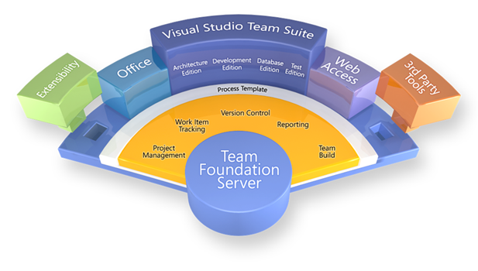

Team Foundation Server (TFS)

Slide 61
Team Foundation Server (TFS)
Team Foundation Server (TFS)
SCM repository from Microsoft
Integrated source control, team collaboration and project tracking system
Deep integration with Visual Studio
Team Explorer
TFS client – free download from Microsoft
Fully integrated into Visual Studio
Part of VS 2012, additional download in VS 2010

Slide 62
CodePlex – Open Source Project Hosting with TFS
CodePlex
Community site for open source projects (mostly .NET projects)
Operated and supported by Microsoft
Provides free public TFS repository for open source projects
Anyone can register as developer, join existing projects and create own projects
Web site: http://codeplex.com

Slide 63
MS Team Foundation Service –TFS Hosting from Microsoft
MS Team Foundation Service
Private TFS server infrastructure in the cloud
Operated and supported by Microsoft
Free TFS repository for 5 users
Paid plans for bigger projects
Anyone can register as developer, join existing projects and create own projects
Web site: http://tfs.visualstudio.com

Slide 64
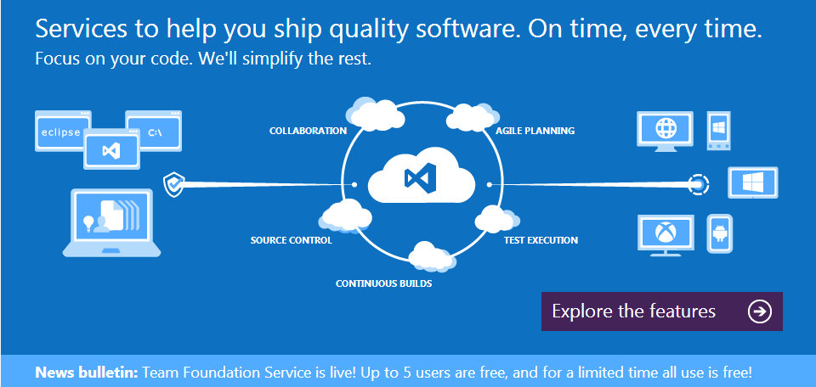
Team Foundation Server at tfs.visualstudio.com
Live Demo

Slide 65
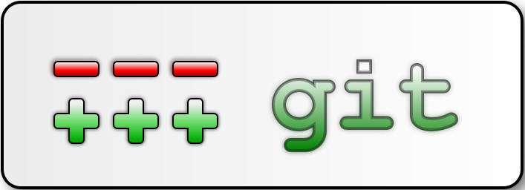
Git Crash Course

Slide 66
Git Crash Course
Git
Distributed source-control system
Work with local and remote repositories
Git bash – command line interface for Git
Free, open-source
Has Windows version (msysGit)
http://msysgit.github.com

Slide 67
Git Crash Course (2)
msysGit Installation
“Next, Next, Next” does the trick
Options to select (they should be selected by default)
“Use Git Bash only”
“Checkout Windows-style, commit Unix-style endings”
Note: this concerns only beginners

Slide 68
Git Crash Course (3)
Using Git Bash
Standard command prompt with added features
Creating a local repository
git init
Preparing (adding/choosing) files for a commit
git add [filename] ("git add ." adds everything)
Committing to a local repository
git commit –m "[your message here]"

Slide 69
Git Crash Course (4)
Using Git Bash (2)
Git “remote”– name for a repository URL
Git “master” – the current local branch (think of it as “where you have committed”)
Creating a remote
git add remote [remote name] [remote url]
Pushing to a remote (sending to a remote repository)
git push [remote name] master

Slide 70



Using Git Bash
Live Demo

Slide 71

Project Hosting and Team Collaboration Sites
SourceForge, Google Code, CodePlex, Project Locker

Slide 72
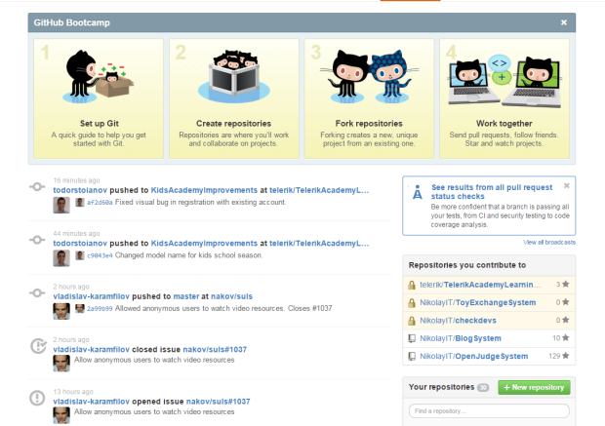
Project Hosting Sites
GitHub – https://github.com
The #1 project hosting site in the world
Free for open-source projects
Has paid plans for private projects
TourtoiseGit exists for Git source controls
https://code.google.com/p/tortoisegit/
Dramatically simplifies Git
Perfect for beginners
Same as the SVN version

Slide 73
Project Hosting Sites
SourceForge – http://www.sourceforge.net
Source control (SVN, Git, …), web hosting, tracker, wiki, blog, mailing lists, file release, statistics, etc.
Free, all projects are public and open source
Google Code – http://code.google.com/projecthosting/
Source control (SVN), file release, wiki, tracker
Very simple, basic functions only, not feature-rich
Free, all projects are public and open source
1-minute signup, without heavy approval process

Slide 74
Project Hosting Sites (2)
CodePlex – http://www.codeplex.com
Microsoft's open source projects site
Team Foundation Server (TFS) infrastructure
Source control (TFS), issue tracker, downloads, discussions, wiki, etc.
Free, all projects are public and open source
Project Locker – http://www.projectlocker.com
Source control (SVN), TRAC, CI system, wiki, etc.
Private projects (not open source)
Free and paid editions

Slide 75
Project Hosting Sites (3)
Assembla – http://www.assembla.com
Source control (SVN, Git), issue tracker, wiki, chats, files, messages, time tracking, etc.
Private / public projects, free and paid editions
Bitbucket – http://bitbucket.org
Source control (Mercurial), issue tracker, wiki, management tools
Private projects, free and paid editions
Others: Unfuddle, XP-Dev, Beanstalk

Slide 76

Google Code
Live Demo

Slide 77
GitHub
Live Demo

Slide 78



Software Configuration Management (SCM)
Questions?

Slide 79
Exercises
Play with Subversion. Work in teams of 3-10 people.
Register a SVN repository in Google Code (one per team). Add your teammates to the project.
Upload a few of your projects (C# / HTML code / etc.).
Each team member: change something locally. Commit your changes into the SVN repository.
Intentionally make a conflict: each team member simultaneously edits one of the files and tries to commit. In case of conflict merge locally and commit.
Review the Subversion history (change log).
Revert to a previous version and commit.

Slide 80
Exercises (2)
Play with GitHub. Work in teams of 3-10 people.
Register a Git repository in GitHub (one per team). Add your teammates to the project.
Upload a few of your projects (C# / HTML code / etc.).
Each team member: change something locally. Commit and push your changes into GitHub.
Intentionally make a conflict: each team member simultaneously edits one of the files and tries to commit. In case of conflict merge locally and commit.
Review the project history (change log) at GitHub.
Revert to a previous version and commit.

Slide 81
Exercises (3)
Play with TFS. Work in teams of 3-10 people.
Register a TFS account and project repository at http://tfs.visualstudio.com (one per team).
Upload a few of your projects (C# / HTML code / etc.).
Each team member: change something locally. Check-in your changes into the TFS repository.
Intentionally make a conflict: each team member simultaneously edits a file and tries to check-in. In case of conflict merge locally and check-in.
Review the TFS history (change log) for the project.
Revert to a previous version and check-in.

Slide 82
Exercises (4)
Create a pubic repository for your personal projects (developer profile) in GitHub or CodePlex or Google Code or somewhere else. Upload a few of your best projects in it. These project will serve as part of your CV, so select good projects only. Send as homework the link to your public repository (e.g. in a text file).

